Slide 1


I Project Presentation (KCS 753) Soil Testing And Crop Recommendation
KIET Group of Institutions, Ghaziabad
(An ISO – 9001: 2008 Certified & ‘A+’ Grade accredited Institution by NAAC)
PCS 24-31
Guide Name: Prof. Anurag Mishra
1. Sanjeev Kumar 2000290120133 (B)
2. Rahul Singh 2000290120122 (B)
3. Priyanshu Kumar 2000290120118 (B)

Slide 2
Problem Statement
In the last few decades, it is observed that farmers are using fertilizer for the better production of crop. Because fertilizer provides necessary nutrients for higher production of crop. But it is also observed that farmers are using fertilizer in any quantity without knowing the actual nutritional need of the soil and plant which is grown.
Because of this there are some farmers who are using more chemical fertilizer as needed by a crop to grow. And there are some farmers who are using less fertilizer as needed by a crop to grow. This unmeasured use of fertilizer affects the cost of production and quantity of production, which ultimately affect the farmer and financial stability of farmer.

Slide 3
Objectives
The main objective is to evaluate the fertility and nutrients available in the given soil and provide a recommendation on the amount of manure and fertilizer based on soil test value and according to crop.
To avoid excess use of fertilizer and to ensure environmental safety.
To test the soil timely and to reduce the loss of fertility of soil, because each time when a crop is harvested from the field, the soil losses a considerable amount of nutrients and cause loss of fertility over a long time.
Increasing the production of crop and profitability of farmer by providing necessary nutrients to the crop.
By the effective and efficient use of fertilizer and pesticides, the soil and water pollution can be reduced which eventually leads to clean environment.
Reduce the losses of crop due to crop disease.

Slide 4
Technology Used
Machine Learning
Python
Scikit Learn
Deep Learning
Web Development
Front End
HTML, CSS, JavaScript
Back End
NODEJS, FLASK

Slide 5
Literature Survey

Slide 6
Artificial Intelligence (AI) in Agriculture Excellent Publishers V. Dharmaraj* and C. Vijayanand (2018)
The abstract discusses the pressing challenge of feeding a growing global population with limited arable land. It emphasizes the potential of Artificial Intelligence (AI) in revolutionizing agriculture by enabling more efficient and productive farming practices. The paper explores AI applications in cognitive computing, IoT-driven development, and image-based insights for disease detection, crop management, and field optimization. It also highlights AI's role in recommending crop choices based on various parameters. The paper mentions real-world examples, such as Microsoft's work with farmers in India, where AI has led to a 30% increase in crop yields. Overall, it envisions AI as a critical tool in achieving sustainable agriculture for the future.

Slide 7
Artificial Intelligence (AI) in Agriculture IEEE Simon Y. Liu (2020)
This abstract emphasizes the critical role of Artificial Intelligence (AI) in addressing the challenges posed by a growing global population, limited agricultural land, and climate uncertainties. It discusses the establishment of a Center of Excellence (COE) by the United States Department of Agriculture (USDA) to lead AI applications in agricultural research. The abstract highlights various AI applications in agriculture, such as production management, crop monitoring, data analysis, disease detection, food quality assessment, and predictive analytics. These AI technologies are revolutionizing farming practices, enhancing resource efficiency, and boosting crop yields. The Special Section offers insights and case studies demonstrating AI's potential to transform the future of agriculture.

Slide 8
IoT, Big Data, and Artificial Intelligence in Agriculture and Food Industry IEEE Internet of Things Journal N. N. Misra (2022)
This review explores the disruptive role of the Internet of Things (IoT), big data, and artificial intelligence (AI) in revolutionizing agricultural and food systems. It underscores the significance of both sensor-generated and social media-derived big data in monitoring these processes. The applications covered range from precision agriculture through greenhouse monitoring and drone-based crop imaging to supply chain modernization, social media's role in food innovation and sentiment analysis, food quality assessment via spectral methods and sensor fusion, and food safety via gene sequencing and blockchain-based traceability. The review provides insights into the commercial status and translational research outcomes of these technologies.

Slide 9
Big Data and AI Revolution in Precision Agriculture IEEE Showkat Ahmad Bhat(2021)
This article delves into the role of Information and Communication Technology (ICT) in precision agriculture, with a focus on big data technologies such as machine learning and deep learning. It highlights the potential of big data to enhance farming practices, improve decision-making, and address agricultural challenges. The article discusses data creation methods, technology accessibility, software tools, and practical applications of big data in precision agriculture. It also outlines the social and economic challenges associated with the widespread adoption of big data in agriculture. The conclusion emphasizes the transformative impact of big data, artificial intelligence, and IoT on agriculture, addressing issues like sustainability, efficiency, climate change, and food security.

Slide 10
AI applications of data sharing in agriculture 4.0: A framework for role-based data access control International Journal of Information Management Konstantina Spanaki (2021)
The paper explores the concept of Data Sharing Agreements (DSAs) in the context of Agriculture 4.0, emphasizing data management and access control among stakeholders. It applies Artificial Intelligence (AI) techniques to formalize DSAs and address data sharing challenges in the farming sector. The study utilizes a design science approach and presents a smart farm scenario to demonstrate the practical application of AI-driven DSAs. The objectives include enhancing agricultural data management theory, developing DSAs for role-based access control, and extending the approach to broader AI-driven data management in Industry 4.0 contexts. The research informs policymaking and future AI applications for data sharing in agriculture and related industries.

Slide 11
Workflow Diagram
User Input
User Input
N
N
P
Crop
Recommendation
P
ML
ML
Fertilizer
Recommendation
K
K
Temp
Humidity
Crop

Slide 12
Workflow Diagram
Fertilizer
Recommendation
Soil Sample
IOT Sensor
N,P,K Values
Web
Interface
Backend
ML
Algorithm
Output
Crop
Recommendation
Temp
Humidity
Crop
Fetch Through
API
User Input

Slide 13
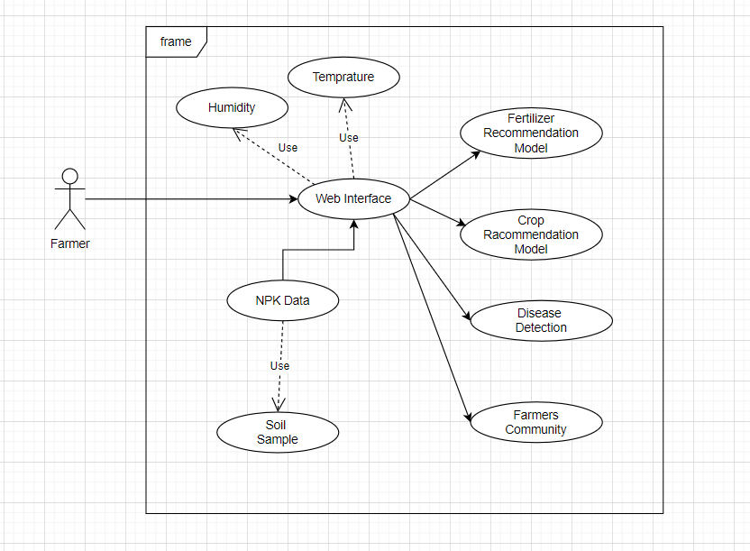
Use Case Diagram

Slide 14
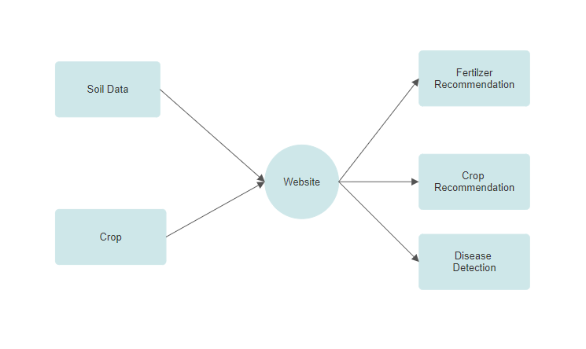
0 – Level DFD

Slide 15
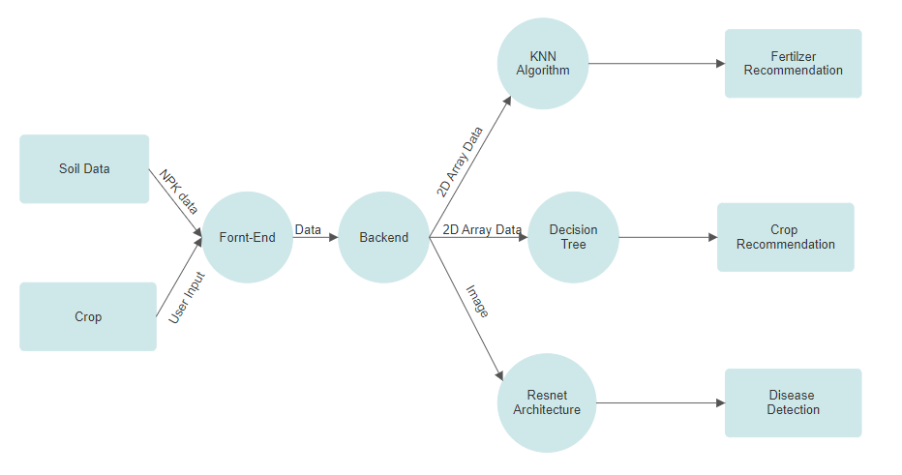
1 – Level DFD

Slide 16
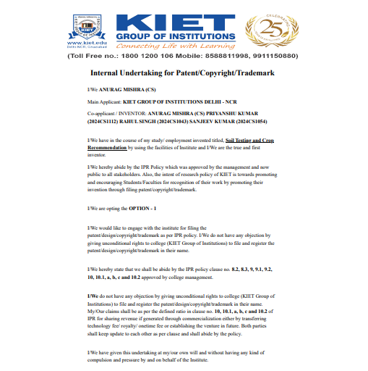
Patent Status

Slide 17
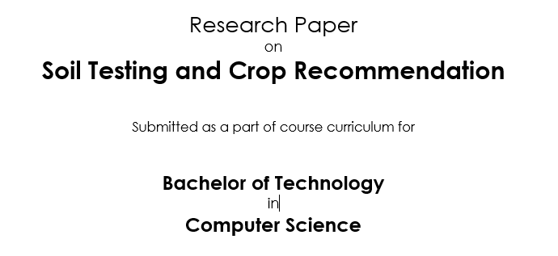
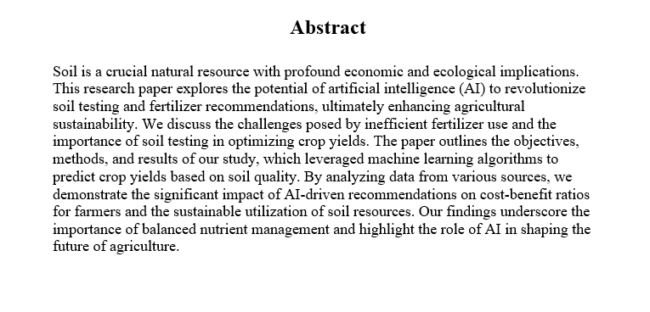
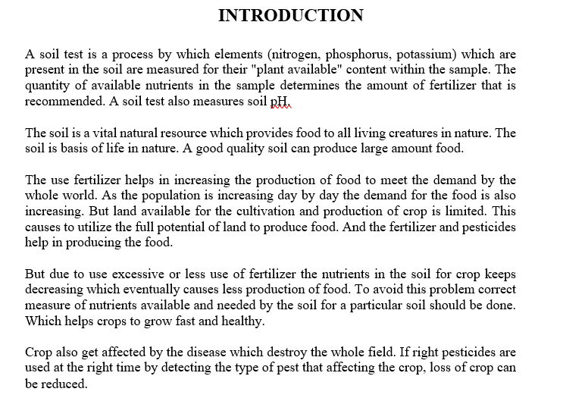
Research Paper Status
Draft Completion 100%
Research Paper
Submitted Research Paper

Slide 18
Project Status
100% of the Project is Completed
Software is Working
Hardware

Slide 19
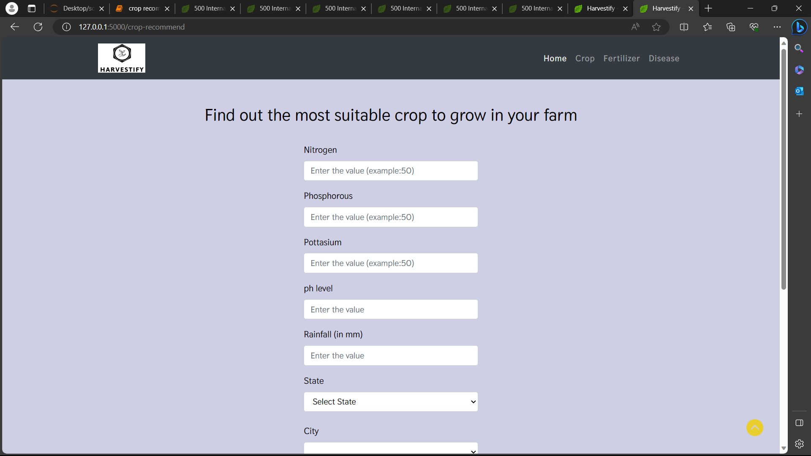
Project Status

Slide 20
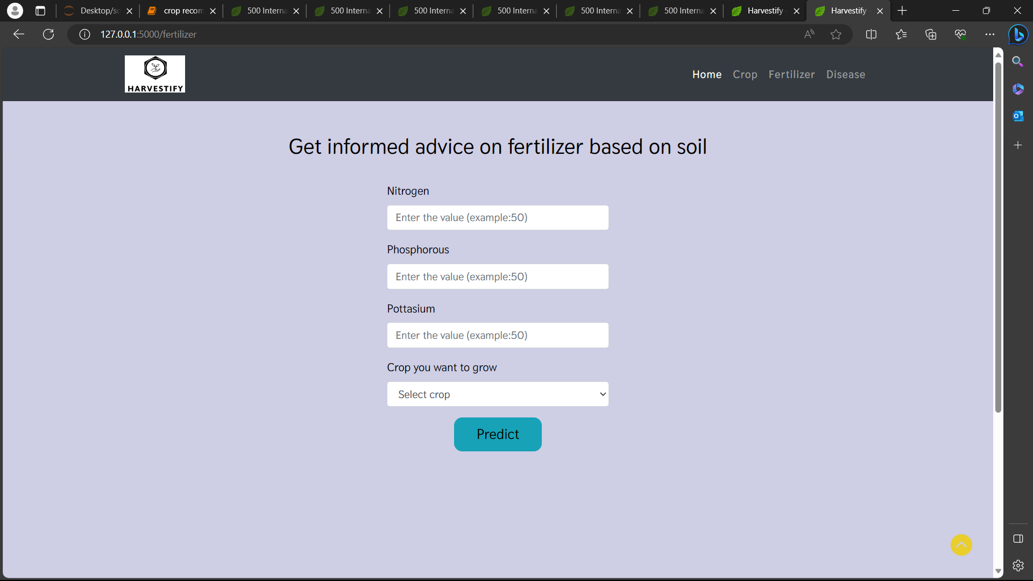
Project Status

Slide 21
References
Badia Melis. R et al., 2016. "Artificial neural networks and thermal image for temperature prediction in apples," Food and Bioprocess Technology, vol. 9 no.7, pp. 1089-1099.
Satyam, P. Geetha, "Comprehensive Overview of the Opportunities and Challenges in AI", 2023 International Conference on Sustainable Computing and Smart Systems (ICSCSS), pp.420-423, 2023.

Slide 22
Thank
You

